Slide 1
sINGAPORE
Land public transport
Ng Wee Herng (2214296), DAAA/FT/1B/01

Slide 2
DATASETS USED
Bus Routes → provided dataset
Bus Services → provided dataset
Bus Stops → provided dataset
MRT Stations → https://www.kaggle.com/datasets/shengjunlim/singapore-mrt-lrt-stations-with-coordinates
Public Transport Utilisation → https://datamall.lta.gov.sg/content/datamall/en/static-data.html#Public%20Transport
Passenger Volume by Bus Stops, Passenger Volume by Train Stations → https://datamall.lta.gov.sg/content/datamall/en/dynamic-data.html#Public%20Transport

Slide 3


OBJECTIVES
Analyze Singapore public transport ridership patterns
Analyze bus efficiency from its many factors (freq, distance, etc.)

Slide 4
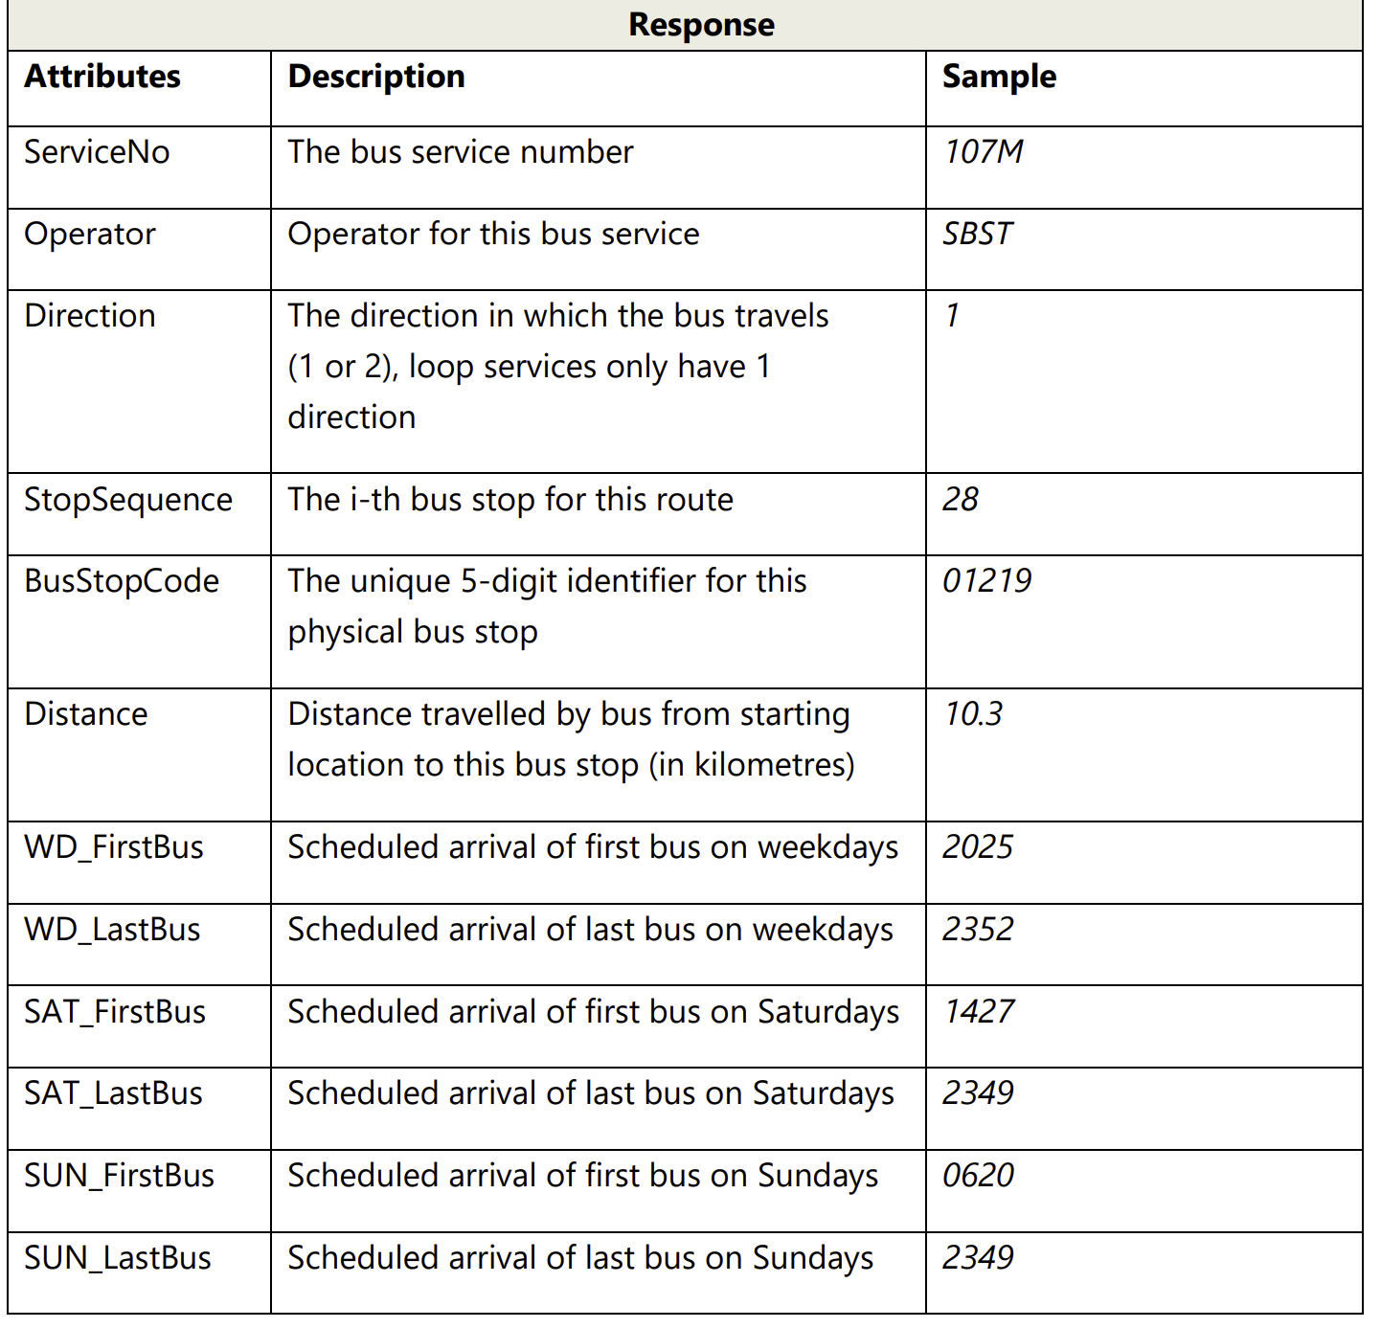
BUS ROUTES
Provided dataset
Contains detailed route information for all services in operation
Contains fields like:
Bus Number, Operator, Stop Code
Stop Sequence
Distance Travelled
Arrival of first/last bus on weekday/weekend

Slide 5
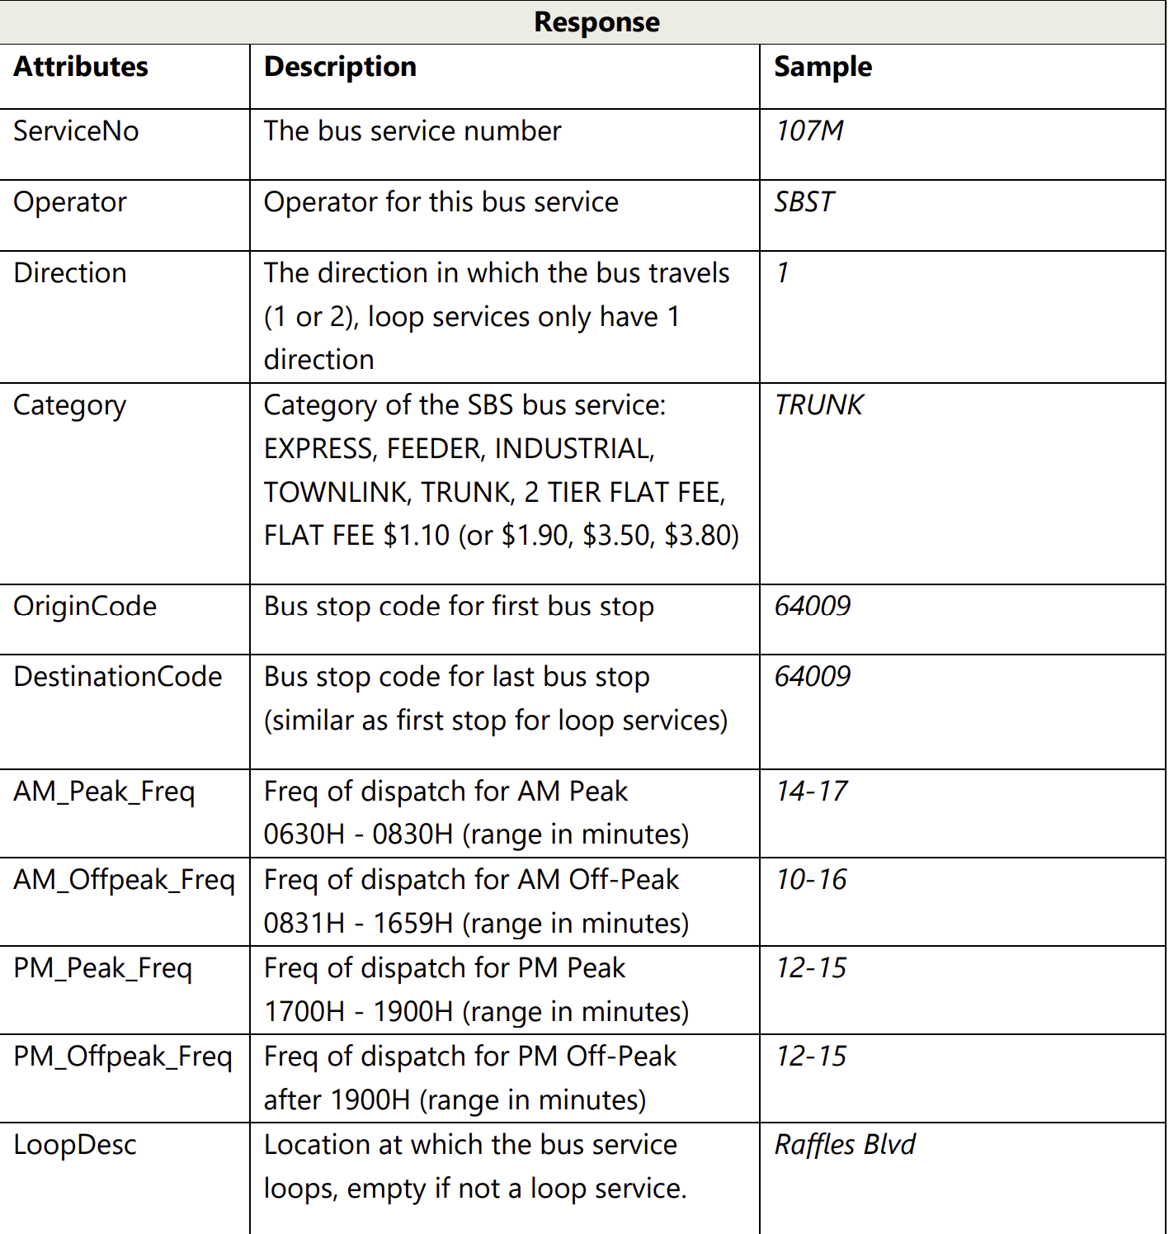
BUS Services
Provided dataset
Contains data on all buses currently in operation.
Contains fields like:
Bus Number, Operator, Category
Origin/Destination bus stop
Frequency of bus in peak/off-peak for AM
Frequency of bus in peak/off-peak for PM

Slide 6
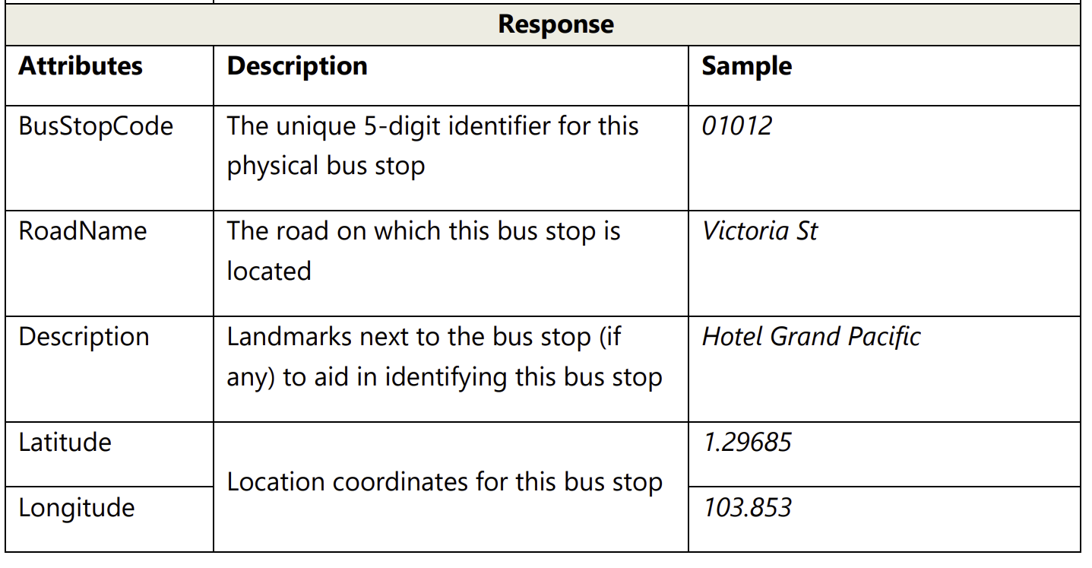
BUS stops
Provided dataset
Contains detailed information on all bus stops currently being serviced by buses
Contains fields like:
Bus stop code
Road
Bus stop name
Coordinates of bus stop

Slide 7
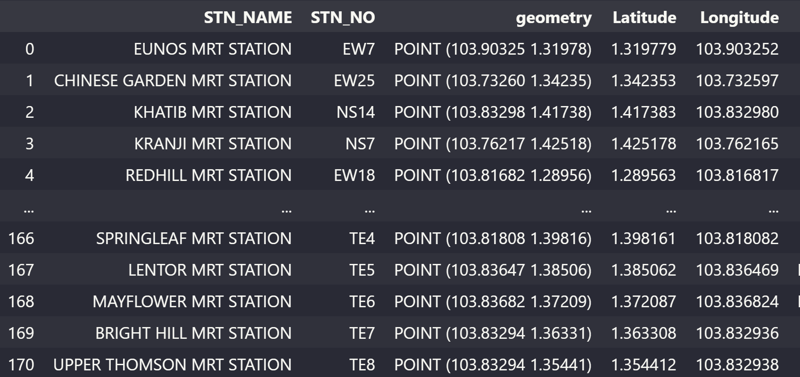
MRT stations
Contains data on the MRT stations in Singapore
Contains fields like:
Station Name, Number
Geometry (lon,lat)
Longitude and Latitude

Slide 8
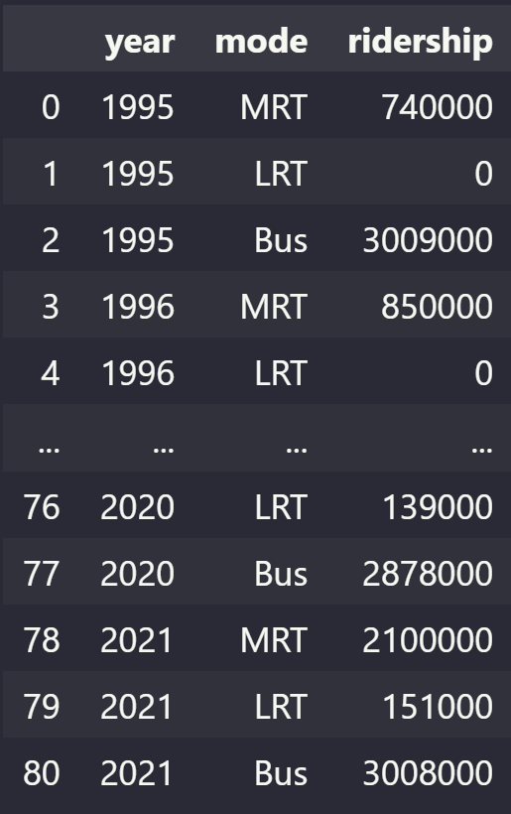
Public transport utilisation
Contains data on the average daily number of trips made island wide on MRT, LRT and buses.
Contains fields like:
Year
Mode of transport
Amount of people riding that mode of transport daily

Slide 9
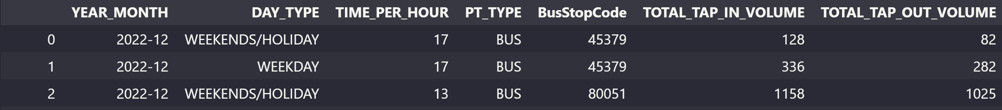
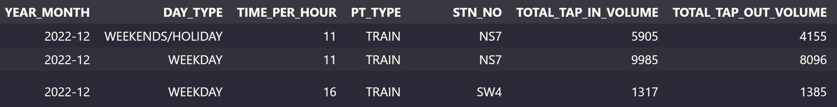
Passenger volume by bus/train
2 similar datasets, 1 on buses, 1 on trains
Contains data tap in and tap out passenger volume by weekdays and weekends for individual bus stop/ train station

Slide 10
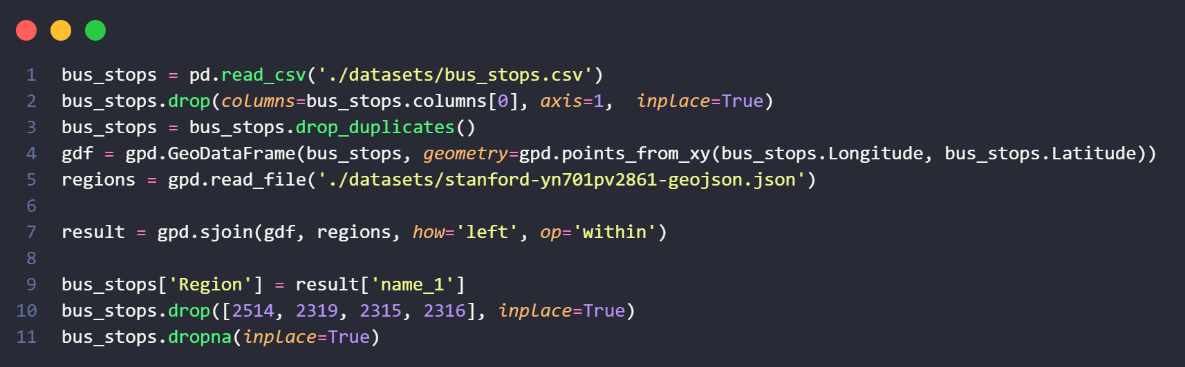
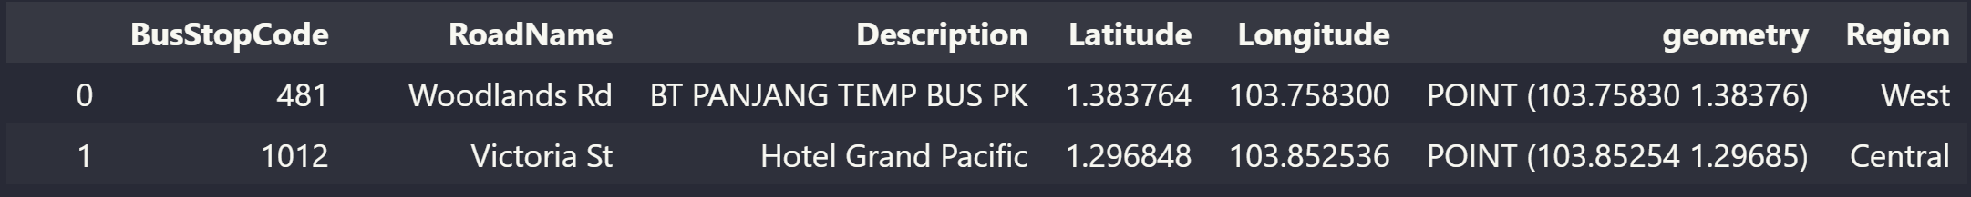
Wrangling data (bus stops)
Removed extra index column
Removed any duplicates if any with .drop_duplicates() function
Downloaded a geojson file on Singapore’s polygon boundaries by region (https://geodata.lib.berkeley.edu/catalog/stanford-yn701pv2861)
Used geopandas to make a column ‘Region’ by using sjoin() function, fitting the coordinates of each bus stop into the boundaries to find out which region it is from
Dropped rows with no region found

Slide 11
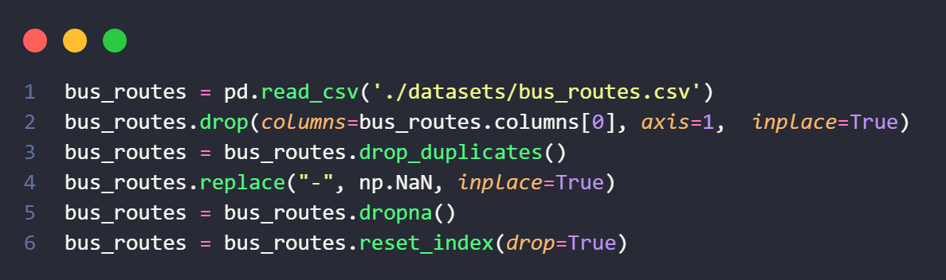
Wrangling data (bus Routes)
Removed extra index column
Removed any duplicates if any with .drop_duplicates() function
Missing data was not denoted with NaN, so was not able to use dropna() function
Used .replace to replace all missing values denoted with – to NaN
Dropped rows with missing values

Slide 12
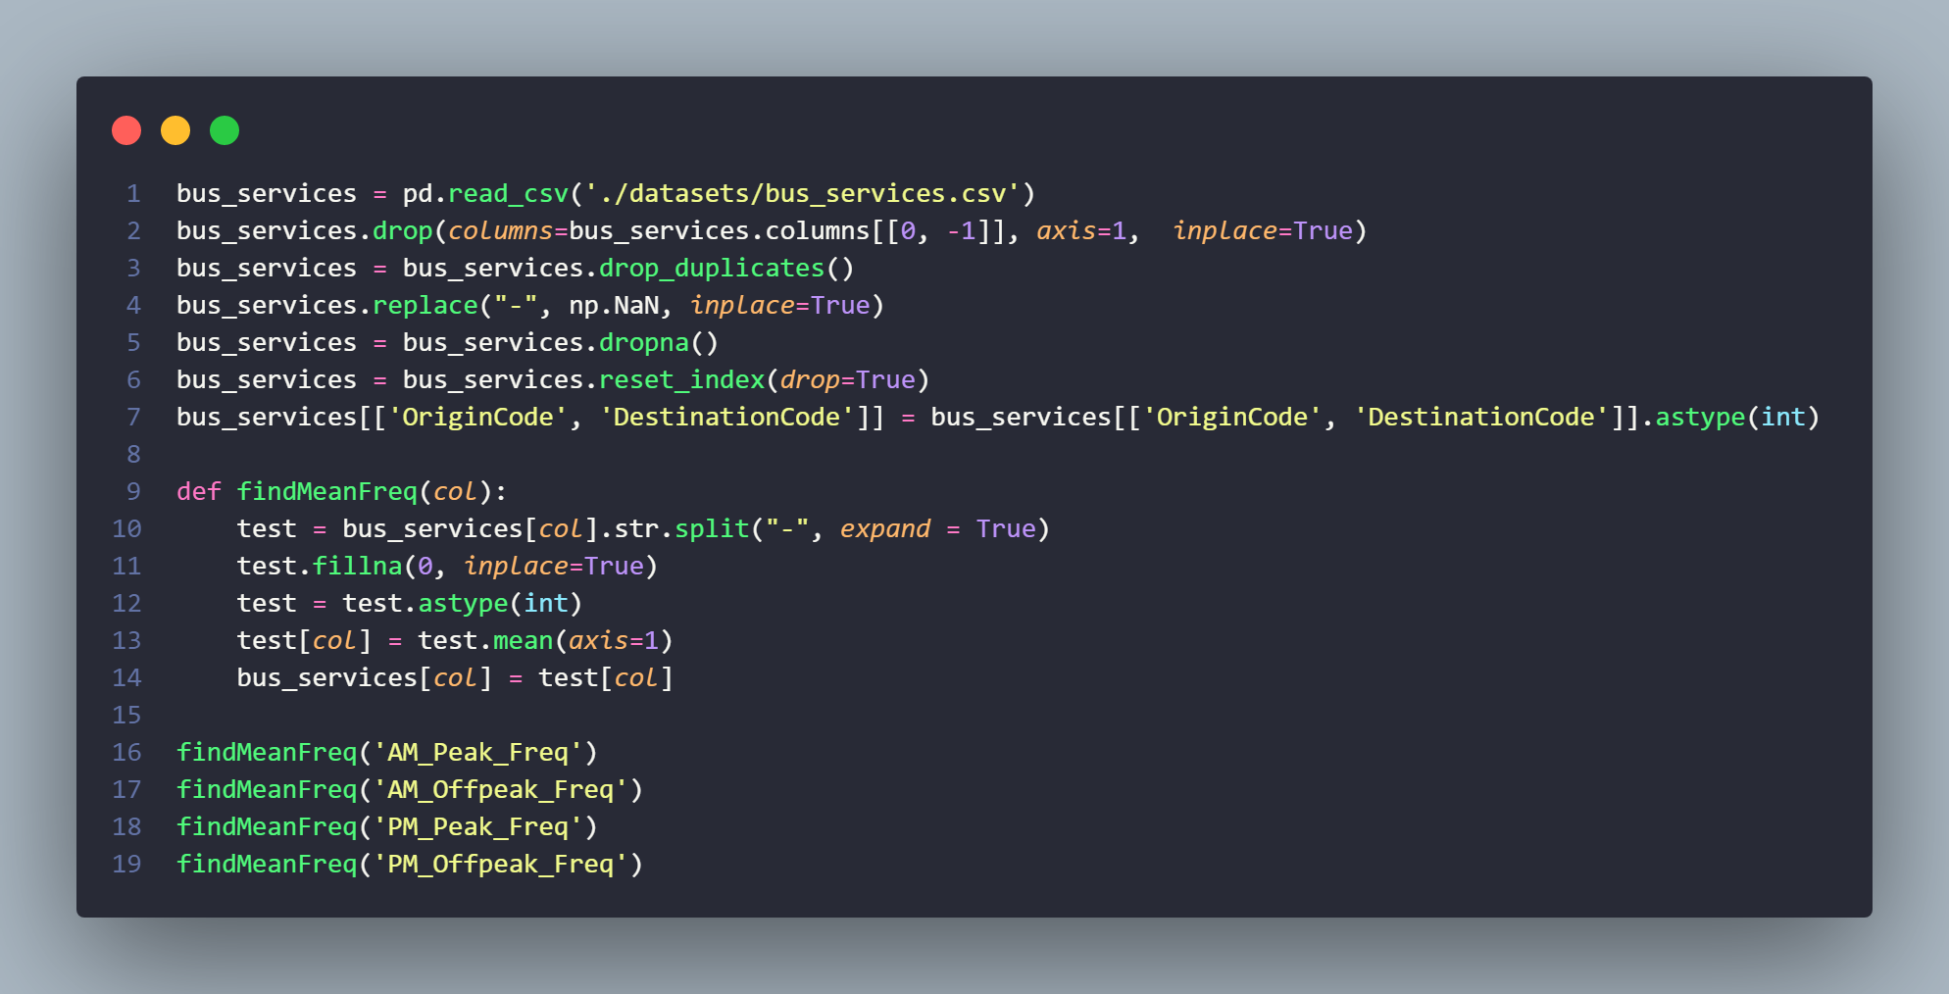
Wrangling data (bus services)
Removed extra index column
Removed Loop Description column as I felt it was of no use
Removed any duplicates if any with .drop_duplicates() function
Missing data was not denoted with NaN, so was not able to use dropna() function
Used .replace to replace all missing values denoted with – to NaN
Dropped rows with missing values
Origin and destination code was in float format with .0, changed to int

Slide 13
Wrangling data (bus services)
Frequency columns were data type of string (3-5, 5-9, etc.)
Split the string to find the lowest and highest frequency time
Columns with only one time had NaN values → replaced with 0
Changed type from string to integer to allow for .mean() function so that the frequency time will be one number
Used a function to change all 4 columns quickly

Slide 14
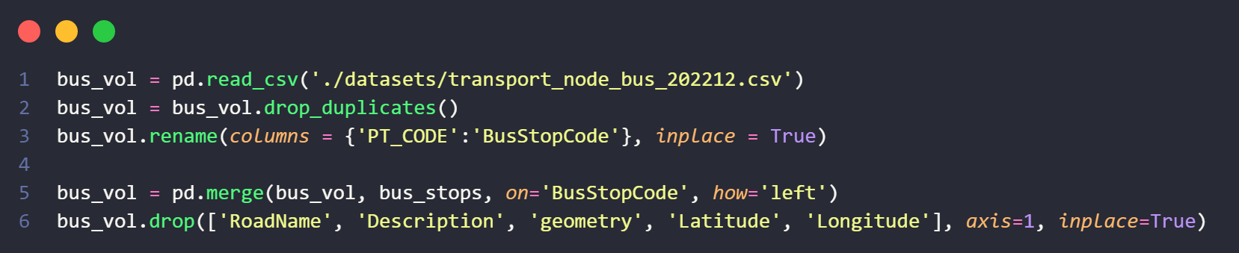
Wrangling data (bus passenger volume)
Dropped duplicates with drop.duplicates() function
Renamed PT_CODE to BusStopCode to be in line with bus stops dataset
Merged bus_vol and bus_stops to get region where each row of data was collected
Removed other columns from bus_stops to get region only

Slide 15
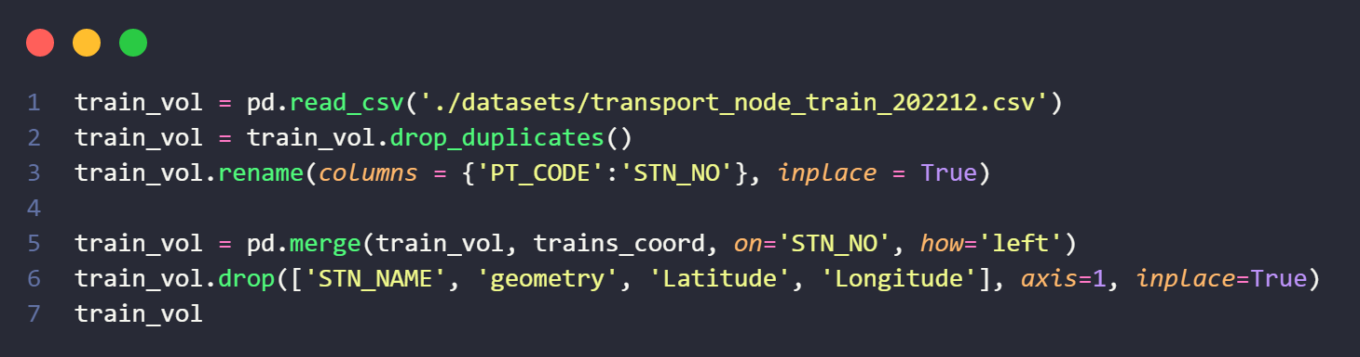
Wrangling data (train passenger volume)
Used MRT Stations dataset with geopandas to give each station a region like with bus stops
Dropped duplicates with drop.duplicates() function
Renamed PT_CODE to STN_NO to be in line with the mrt stations dataset
Drop columns to leave just Region from the other dataset

Slide 16
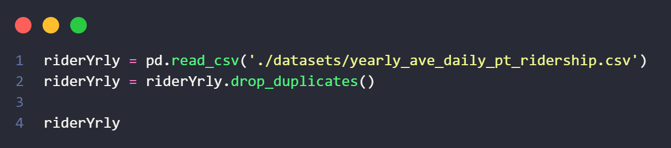
Wrangling data (ridership)
Dropped duplicates with drop.duplicates() function

Slide 17
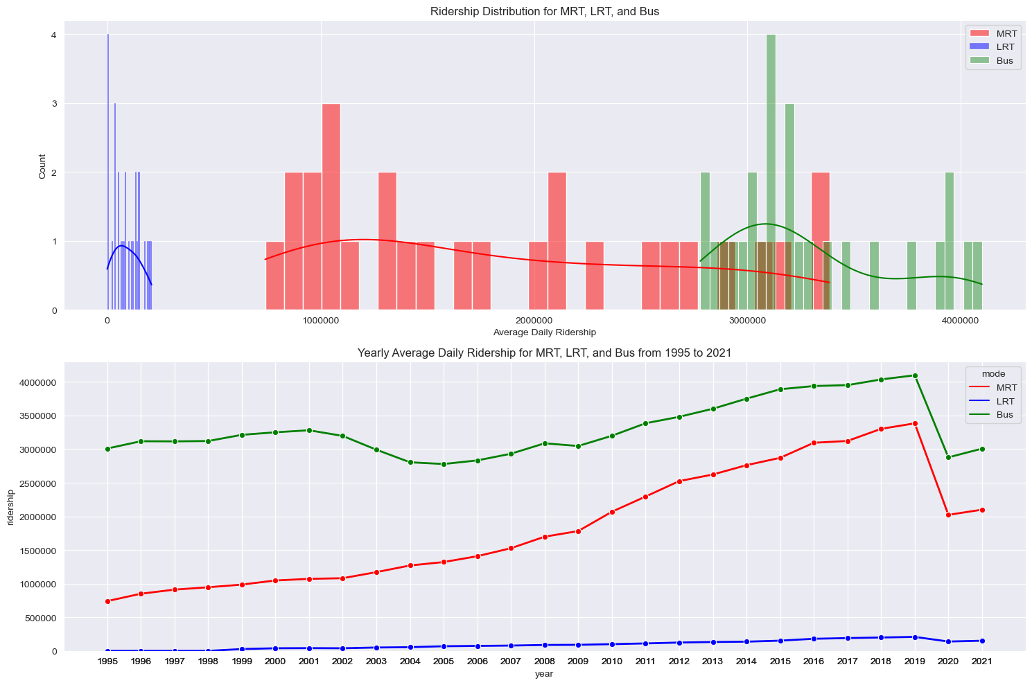
Data Analysis (ridership)
More people take the bus compared to MRT, and more people take MRT compared to LRT.
MRT ridership distribution is very spread out, while the others are less spread out
Line Chart shows that over the years, the difference in average daily ridership between MRT and Bus have decreased
From about 2.25 million to 700,000
The first LRT line opened in 1999, explaining the 0 values for the years before

Slide 18
Data Analysis (ridership)
Average daily ridership drastically dropped after from 2019 to 2020 by about 1.3 million for both MRT and Buses
Due to COVID-19 circuit breaker implemented, adults worked from home and student had home-based learning
Much less public transport usage as people did not have to commute to daily responsibilities on weekdays
Rest of analysis will be focused on MRT and Bus ridership

Slide 19
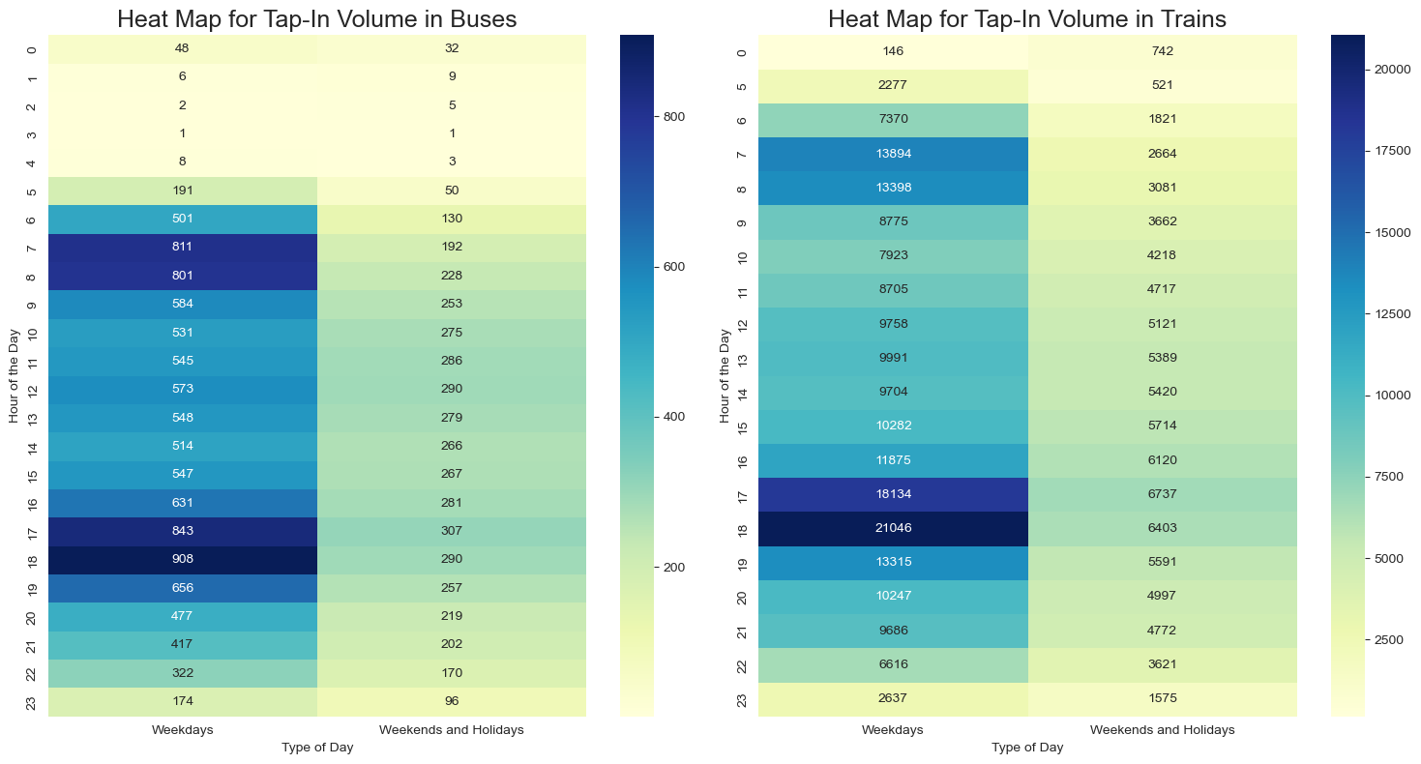
Data Analysis (ridership)
Used .pivot_table() function to format the data for heatmap
The trends between Tap-In Volume in buses and trains are similar.
For buses and trains, the highest tap-in volumes are during the 0600-0800 and 1700-1900 timeframe on weekdays
With the peak being 908 for buses and 21,046 for trains at 1800
6am and 6pm is the peak hours as people are commuting to work and school, and back home at night, thus the high tap-in volumes
For weekends and holidays, the tap-in volumes are much lesser for both buses and trains
This is because there is no work and school, and many families travel by car on weekends and holidays

Slide 20
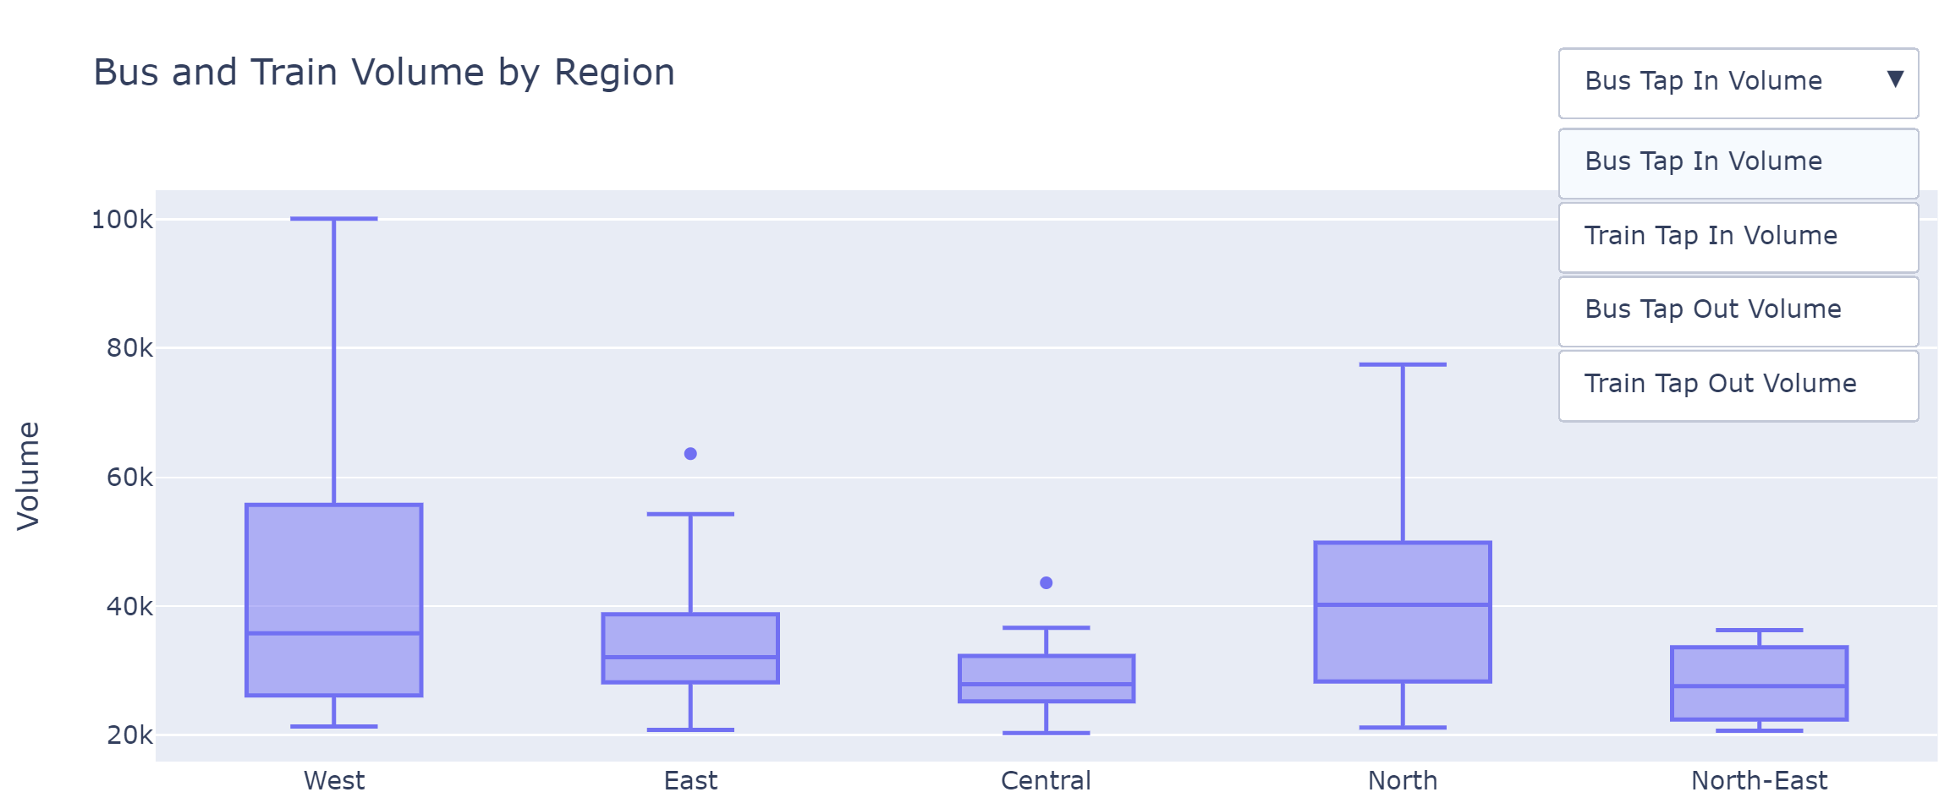
Data Analysis (ridership)
Since there are too many bus stops and train stations, and the difference in volume may be significant, data used was rows with total tap-in/tap-out volume > 20k
North (40.2k) and West (35.8k) regions have the two highest median bus tap-in volumes, while Central (27.9k) has the lowest
West (33.3k) and North (32.8k) regions also have the two highest median train-tap in volumes, while East (24k) has the lowest
West (39k) and North (38.7k) regions have the two highest median bus tap-out volumes, while North-East (22.6k) has the lowest
West (35.3k) and North (34.7k) regions have the two highest median train tap-out volumes, while Central (27k) has the lowest
West region by far has the biggest fence/ outliers, due to Jurong East MRT being one of the busiest MRT stations in peak hours

Slide 21
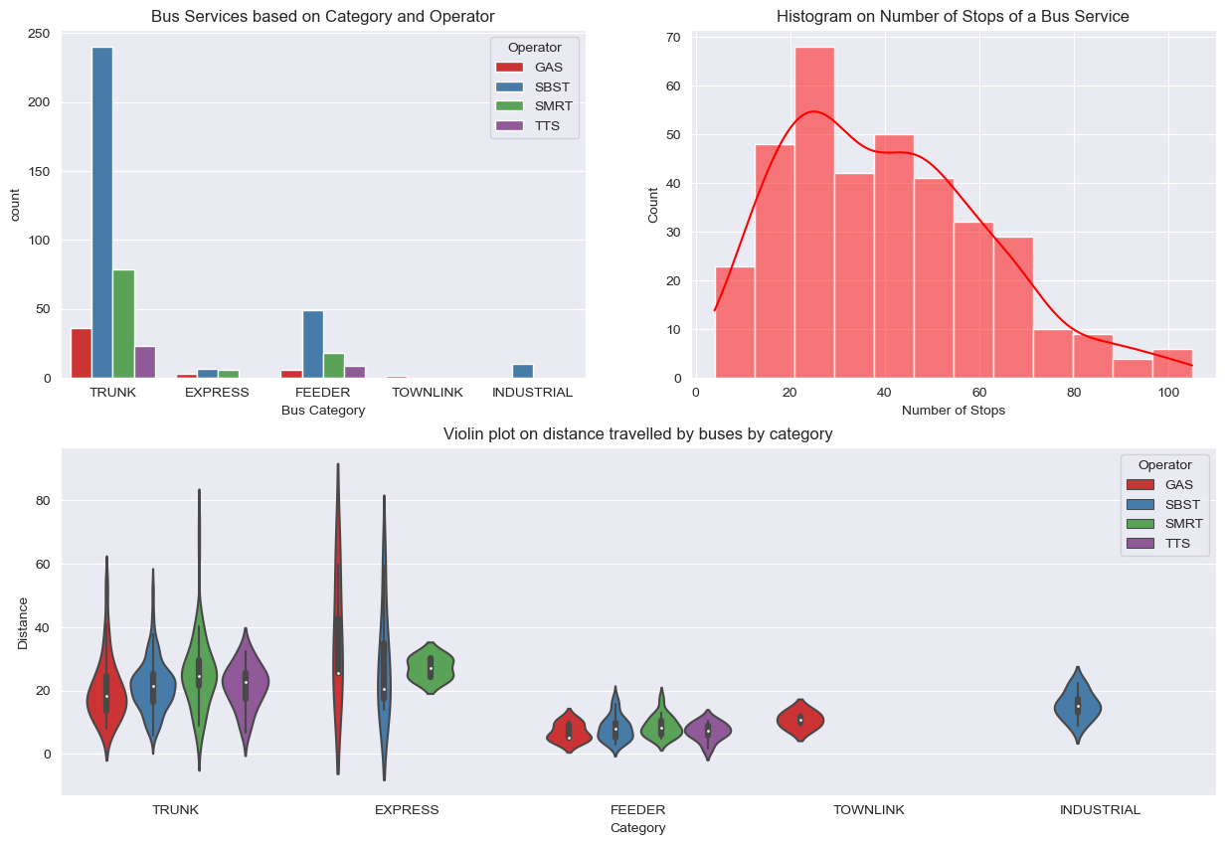
Data Analysis (bus efficiency)
SBS is the largest bus operator in Singapore
The biggest bus category is Trunk, as they are the backbone of the public bus network, bringing people across town
The second biggest is Feeder, as they facilitate movement around neighbourhoods and estates
Little express, townlink and industrial bus services
Histogram shows that most buses have around 20 to 30 stops, with as little as 4 stops to as many as 105
https://www.lta.gov.sg/content/ltagov/en/getting_around/public_transport/bus_network.html

Slide 22
Data Analysis (bus efficiency)
Both townlink and industrial buses have normal distribution due to small number of bus services and similar distances travelled
Shape of distributions are wide around the median (white dot) for feeder and trunk bus services, indicating most of the different buses with different operators travel about the same distance
SMRT Trunk bus services have a narrower distribution, with higher distances travelled for some buses
Express bus services has the most distance travelled, as they skip bus stops or travel by expressways, saving commuting time. SBS and GAS have a thin plot, indicating a very narrow distribution, being skewed to right
https://landtransportguru.net/express-bus-services/

Slide 23
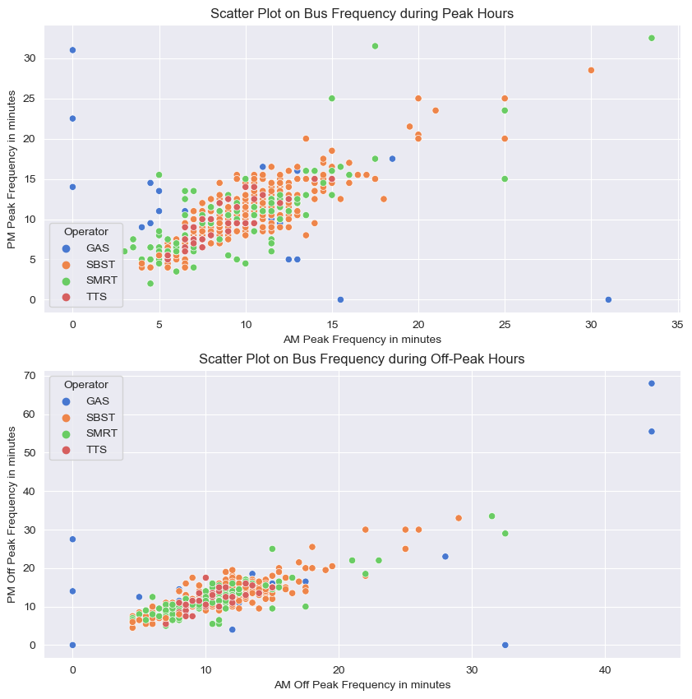
Data Analysis (bus efficiency)
Bus frequencies for peak hours in both AM (0630-0830) and PM (1700-1900) are around 5 to 15 minutes
Bus frequencies for off-peak hours in both AM (0831-1659) and PM(after 1900) are around 10 to 20 minutes
Generally, the bus frequencies during off-peak hours are lower than peak hours since there is a larger volume of people taking public transport during peak hours → more buses are needed
There are some buses operated by SBS and SMRT that have much lower frequency → bus service is not used as much as other bus services by passengers
Some buses have either 0 frequency in minutes → meaning that they do not operate at those timings

Slide 24
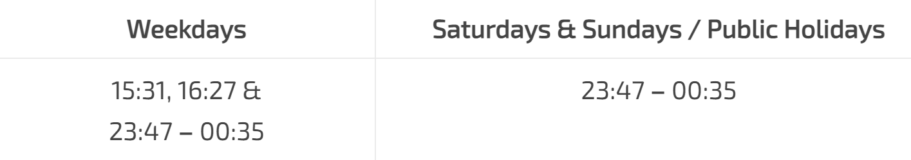
Data Analysis (bus efficiency)
There are a few bus frequencies that are very low, by Go Ahead Singapore (GAS) during off-peak hours. One of them is Bus 3A
However, Bus 3A only operates at certain times, resulting in this very low frequency
https://landtransportguru.net/bus3a/

Slide 25
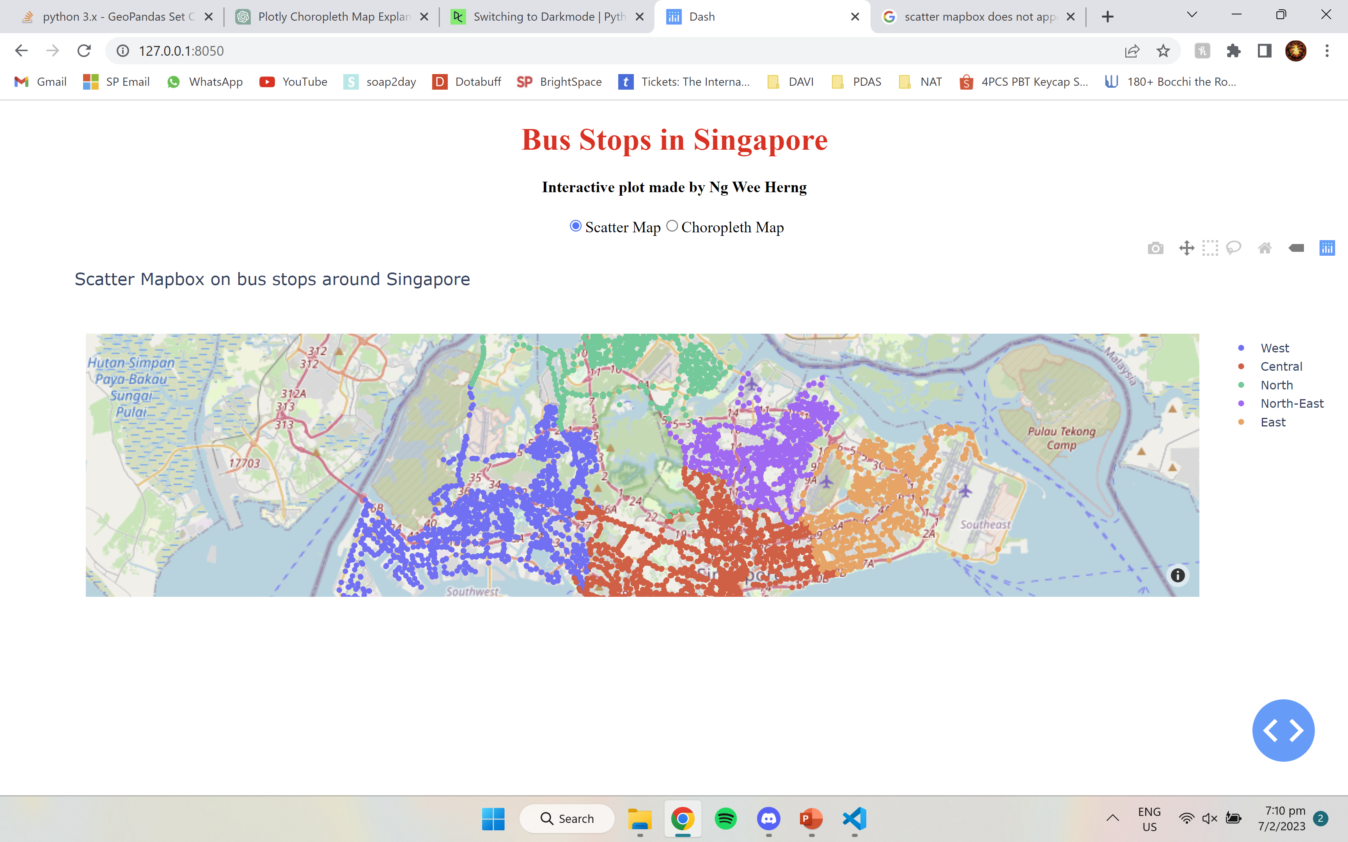
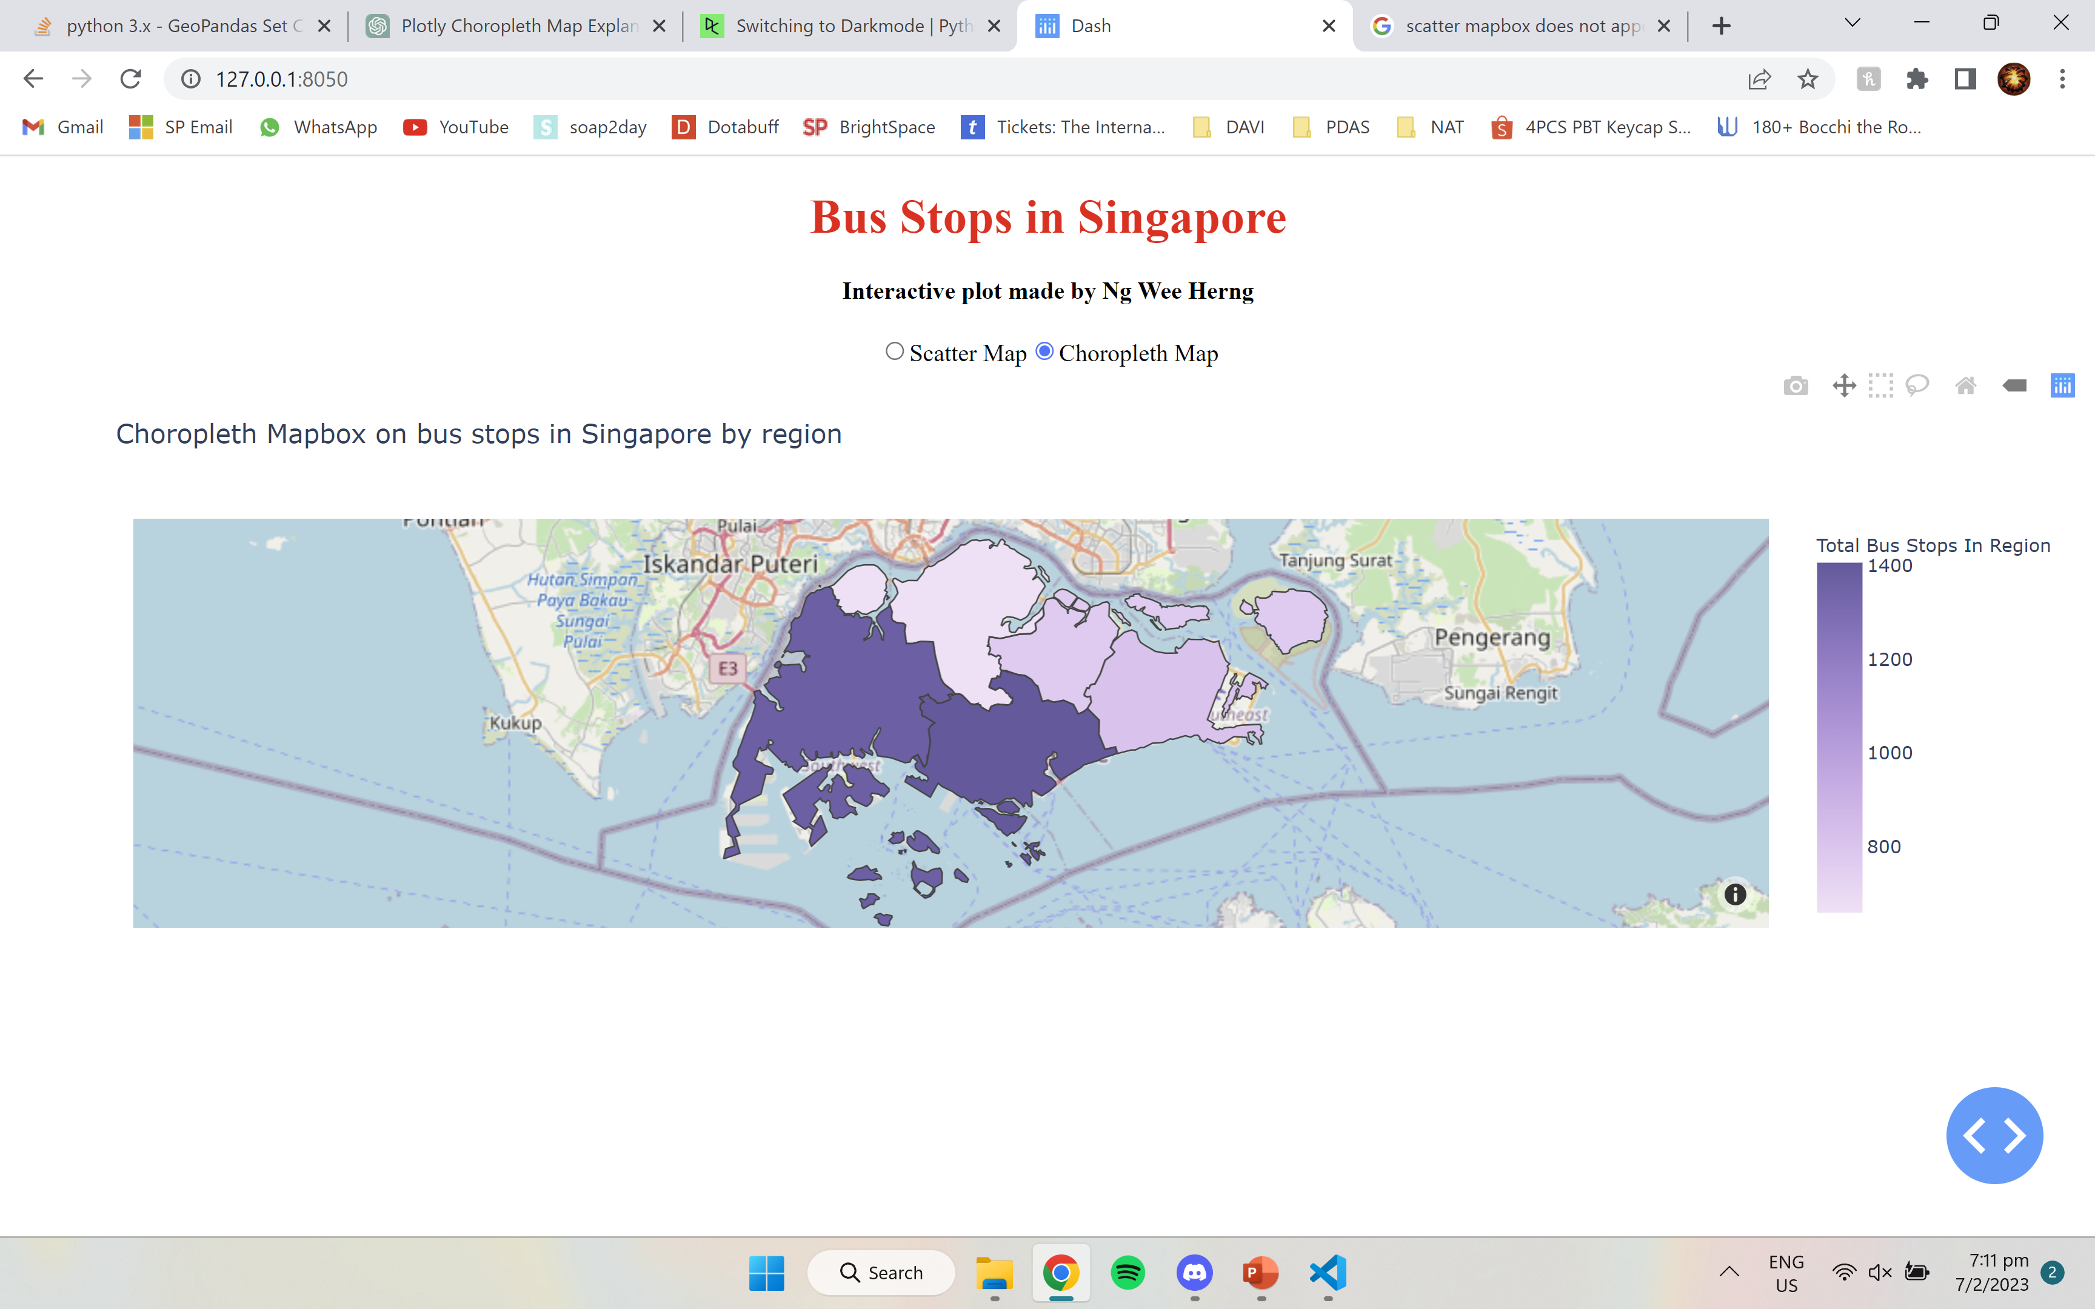
Data Analysis (bus efficiency)
Scatter mapbox made with plotly express and python dash
Radio buttons to toggle between scatter mapbox and choropleth map
Choropleth mapbox shows that the region with the most bus stops is Central (1405), followed by West (1368)
North has the least with 660 bus stops
Scatter mapbox shows that bus stops are all around Singapore and easily accessible, which means bus stops are not a problem in hindering bus efficiency

Slide 26
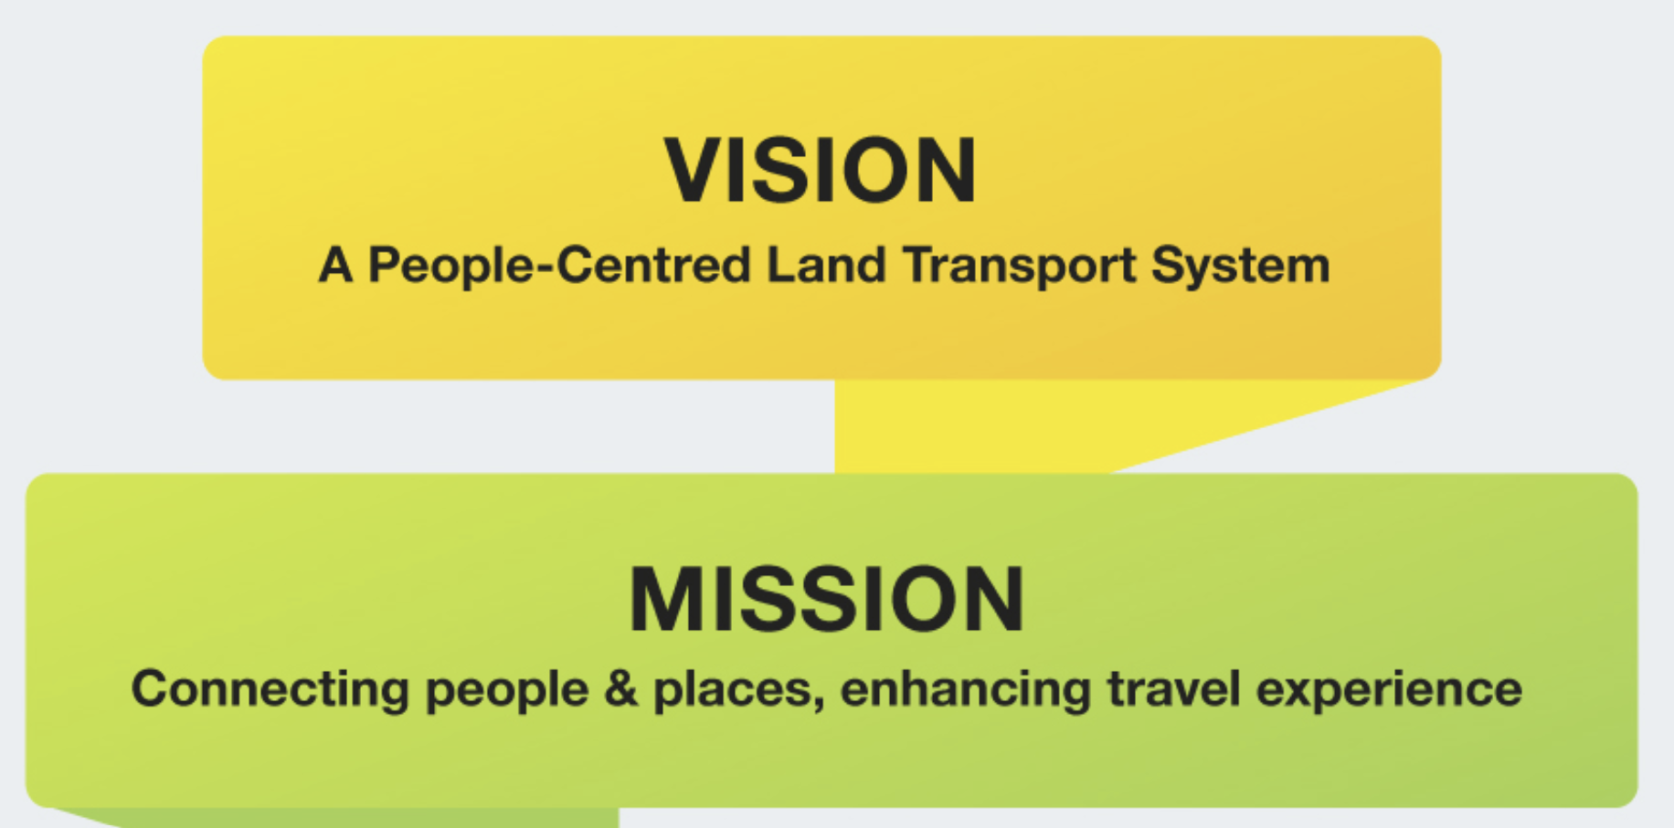
Conclusions and recommendations
As COVID-19 is becoming a part of life and Singapore coming back to normal, daily ridership volumes will start to rise again, maybe even higher than before. Buses should be deployed with higher frequencies at regions where the tap-in volumes are higher like the West and the North.
Bus efficiency has improved over the years, however it is still left to be desired. Bus frequencies during peak hours of the day can still be improved, dispatching more buses to meet the passenger volumes. Since so many people take the bus and transfer to MRT vice versa, the government should look into having more buses of the Feeder category to make sure passengers can have a smooth travel experience.
This can align with LTA’s vision and mission

Slide 27
THANK YOU

